Slide 1

Institution Of Data Mini Project 1
8 July 2020
Ricky K Nguyen

Slide 2
Business question
Is Sydney temperature increase over the year?

Slide 3
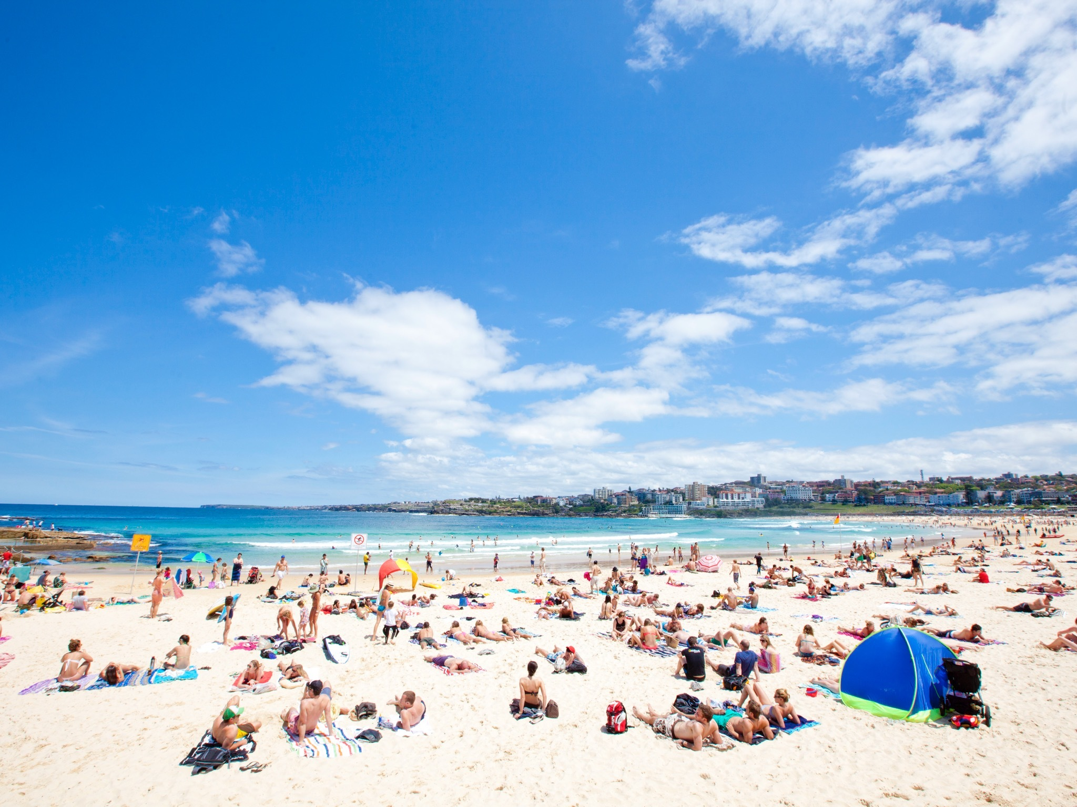
Why ask this question
Australia’s tourism is weather dependent
Tourism is the nation’s second-largest export industry
Valued at $40 billion
Employed 580,000 people
Extreme temperature will affect:
Beaches
Natural wonders
Hotel
Restaurant

Slide 4
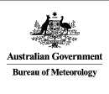
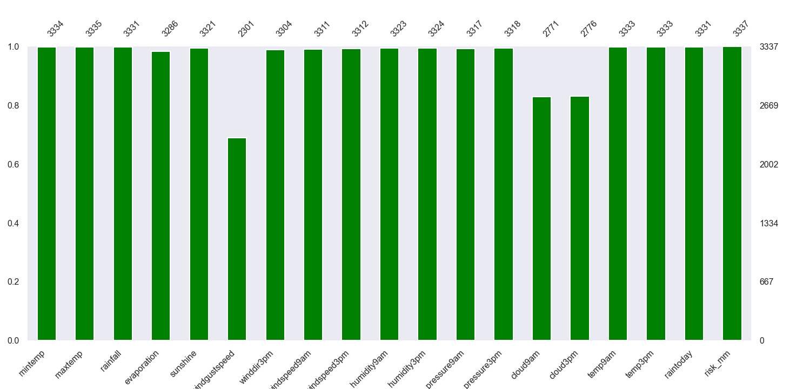
Dataset
Australia Bureau of Meteorology
3337 observations
Range 2008 -2017
24 Features
Missing Data Graph
Frequency
Features

Slide 5
pipeline
Data
Acquisition
Clean &
Exploring
Visualization
Hypothesize
Build Models

Slide 6
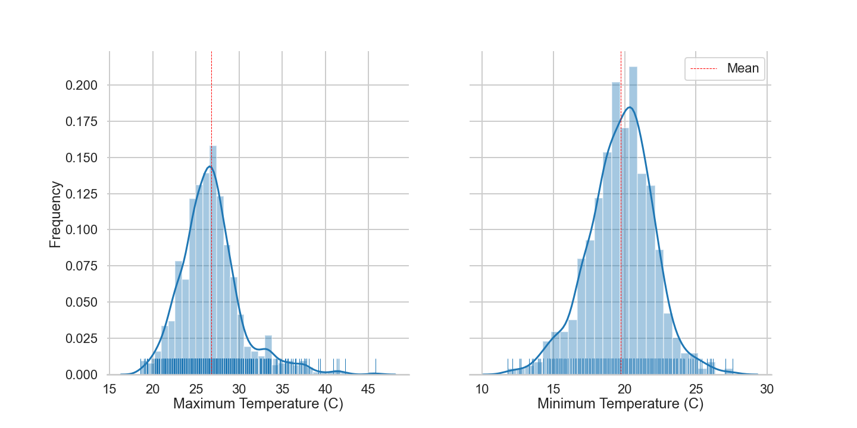
Dataset
Min & Max Temperature Distribution

Slide 7
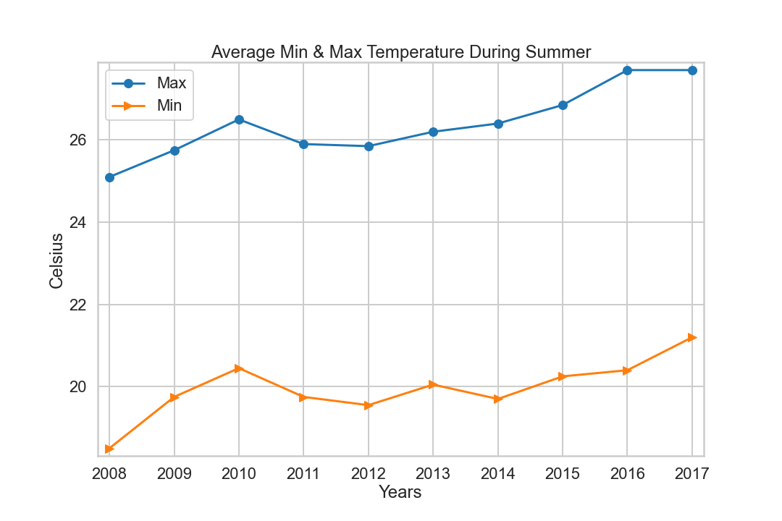
Dataset – cont.

Slide 8
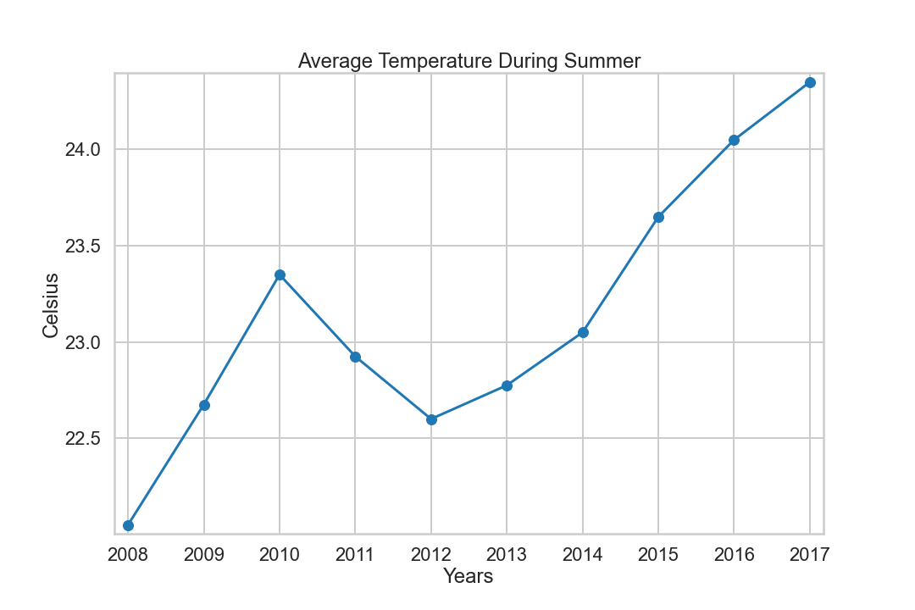
Dataset – Cont.

Slide 9

Hypothesis
H0: no different between data A& data B.
H1: there is difference between our dataset.
Significance level: 5%
Permutation replicates: 0.5%
Z-test: 4.75%
Conclusion:
Sydney temperature is increasing over the year

Slide 10
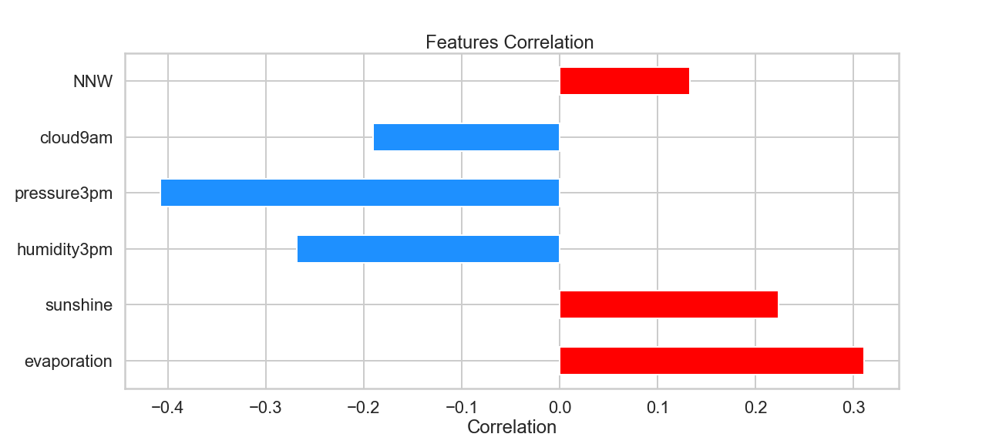
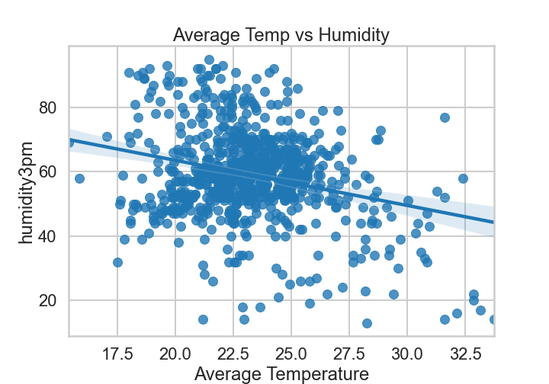
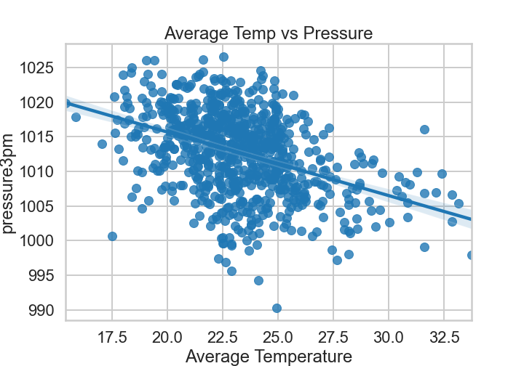
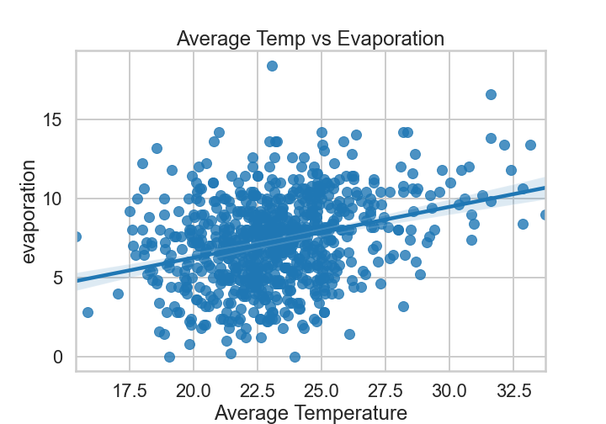
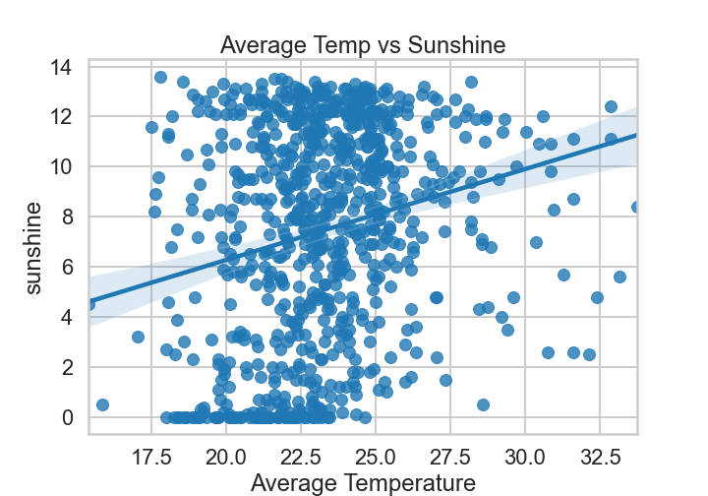
Key findings
Hotter: increases in evaporation, sun duration
Colder: increases in humidity, atmosphere pressure, cloud formation density
NNW winds tend to increase temperature in Sydney

Slide 11
Further improvements
Additional data
Wind speed sources
Global warming data
Carbon dioxide data

Slide 12
Thank you

